Slide 1



Smart Monitoring Systems for Autonomous Vehicles Using IoT
Name of Candidate : MUHAMMAD ANSHAD P A
Register No : 23204036 Date : 27-11-2024
Venue : RCSS
Programme : MCA
Batch : 2022-2024

Slide 2
CONTEXT OF THE TOPIC
Autonomous Vehicles (AVs)
AVs are a significant leap in transportation, utilizing advanced AI, machine learning, and sensory technologies to operate without human intervention.
IoT integration has transformed how AVs interact with their environment, enhancing safety, efficiency, and adaptability.
Importance of IoT in Transportation
IoT enables real-time data collection and analysis, allowing AVs to monitor vehicle health, detect obstacles, and assess road conditions dynamically.
Facilitates communication through Vehicle-to-Vehicle (V2V) and Vehicle-to-Infrastructure (V2I) systems, ensuring seamless traffic flow and reduced accident risks.
Problem Statement
Traditional monitoring systems face limitations in adaptability and real-time responsiveness.
IoT offers solutions by integrating smart tracking and predictive systems, making AVs safer and more reliable.

Slide 3
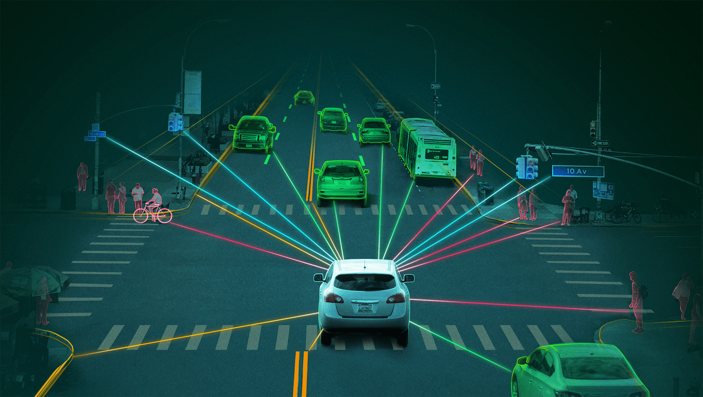
INTRODUCTION
Autonomous vehicles (AVs) are revolutionizing transportation by utilizing advanced technologies like Artificial Intelligence (AI), Machine Learning (ML), and the Internet of Things (IoT) to operate without human intervention. IoT plays a critical role in enabling these vehicles to monitor their environment, process real-time data, and make informed decisions. By integrating sensors, communication systems, and cloud computing, IoT enhances the safety, efficiency, and adaptability of AVs, paving the way for smarter and more sustainable transportation solutions. This seminar explores how IoT-based smart monitoring systems address challenges and improve the functionality of autonomous vehicles.

Slide 4

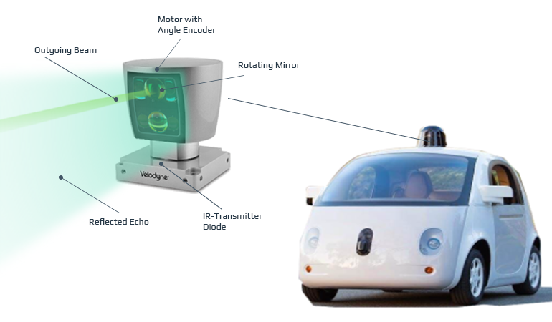
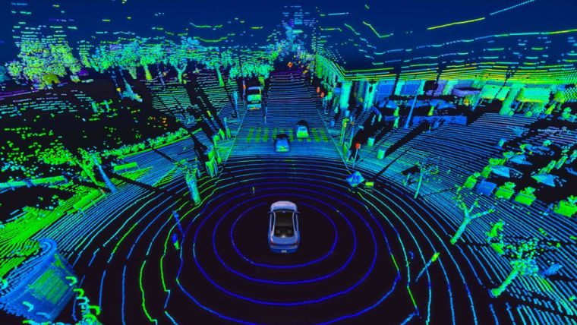
COMPONENTS OF STUDY
IoT Sensors in AVs
LiDAR (Light Detection and Ranging)
Uses laser pulses to detect and map surroundings.
High-resolution data helps identify objects and road features.
Critical for obstacle detection and navigation.

Slide 5
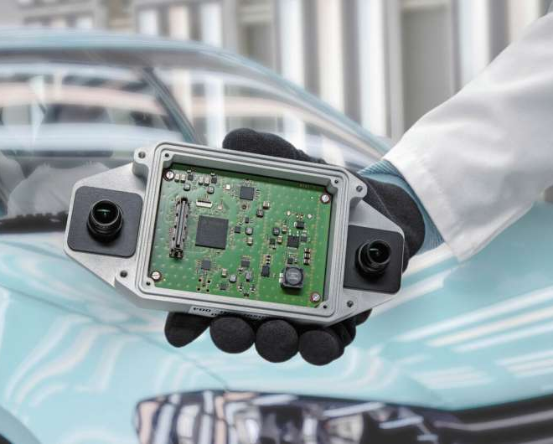
COMPONENTS OF STUDY
Radar
Measures the speed and location of objects.
Effective in low-visibility conditions like fog or rain.
Cameras
Capture visual data for lane detection, traffic signs, and obstacle identification.
Works in conjunction with ML algorithms to classify and recognize objects.

Slide 6
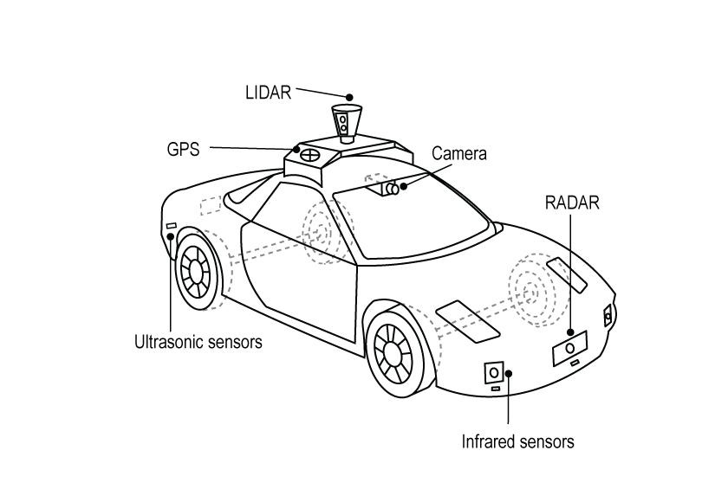
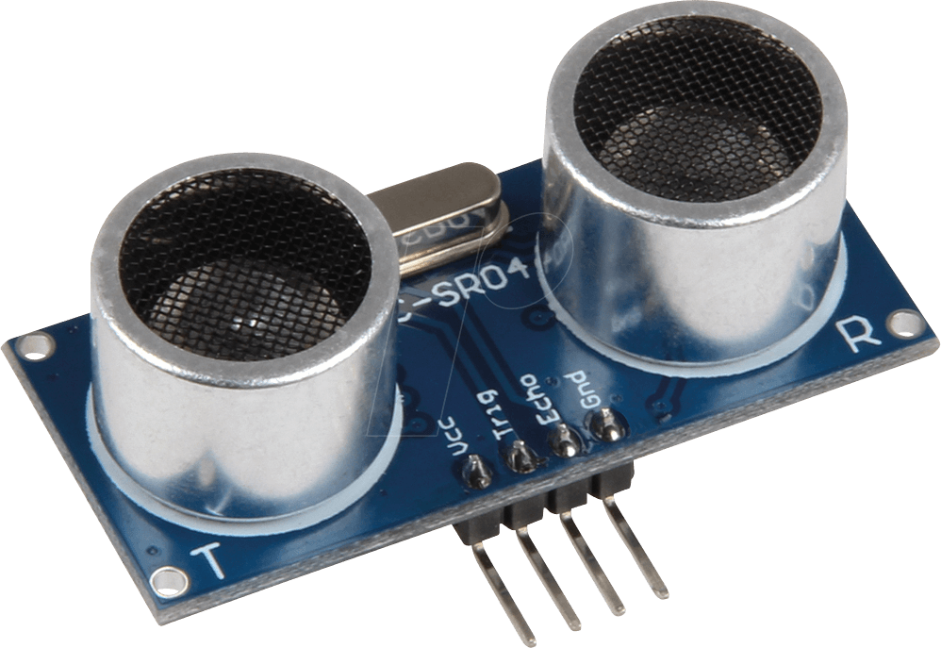
COMPONENTS OF STUDY
GPS
Provides accurate location data for navigation and route planning.
Ultrasonic Sensors
Detect nearby objects for low-speed operations like parking.

Slide 7
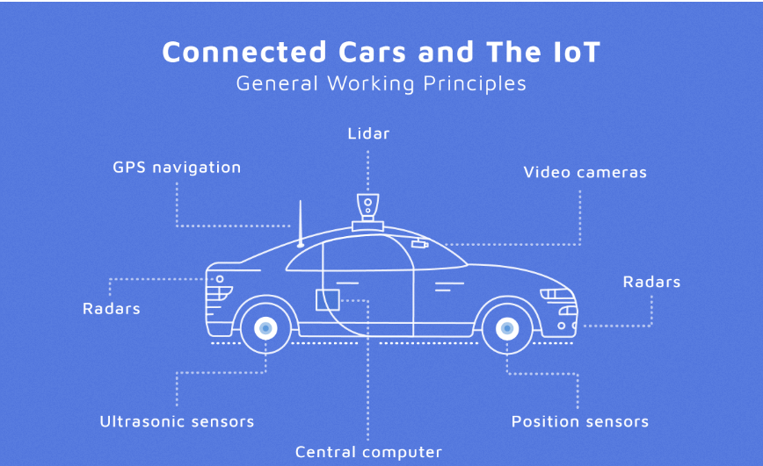
COMPONENTS OF STUDY
Central Computer
Information from all the sensors is analyzed by a central computer , based on the information received the software takes self driving decisions such as steering , accelerator and brakes.

Slide 8
COMPONENTS OF STUDY
Technologies for Data Processing and
Communication
Edge Computing:
Processes data close to the vehicle, reducing latency and enabling faster decisions.
Essential for tasks like obstacle avoidance and adaptive cruise control.
5G Networks:
Provides high-speed, low-latency connectivity between vehicles and the cloud.
Facilitates seamless V2V and V2I communication.
Cloud Computing:
Stores large volumes of data for analysis and long-term insights.
Enables predictive modeling for improving navigation and maintenance.

Slide 9
COMPONENTS OF STUDY
Algorithms and Software Systems
Advanced Driver Assistance Systems (ADAS):
Perception: Detects and classifies obstacles.
Localization: Determines vehicle’s position in its environment.
Planning: Maps the safest and most efficient route.
Control: Executes the planned actions (e.g., braking, steering).
Machine Learning Algorithms:
CNNs (Convolutional Neural Networks): Recognizes objects from sensor data.
Examples: HydraNet (Tesla), ChauffeurNet (Waymo), Nvidia’s self-driving software.
Data Reduction Techniques: Recognizes objects from sensor data.
PCA, SVM, HOG, YOLO: Simplify and classify data for quick processing.

Slide 10
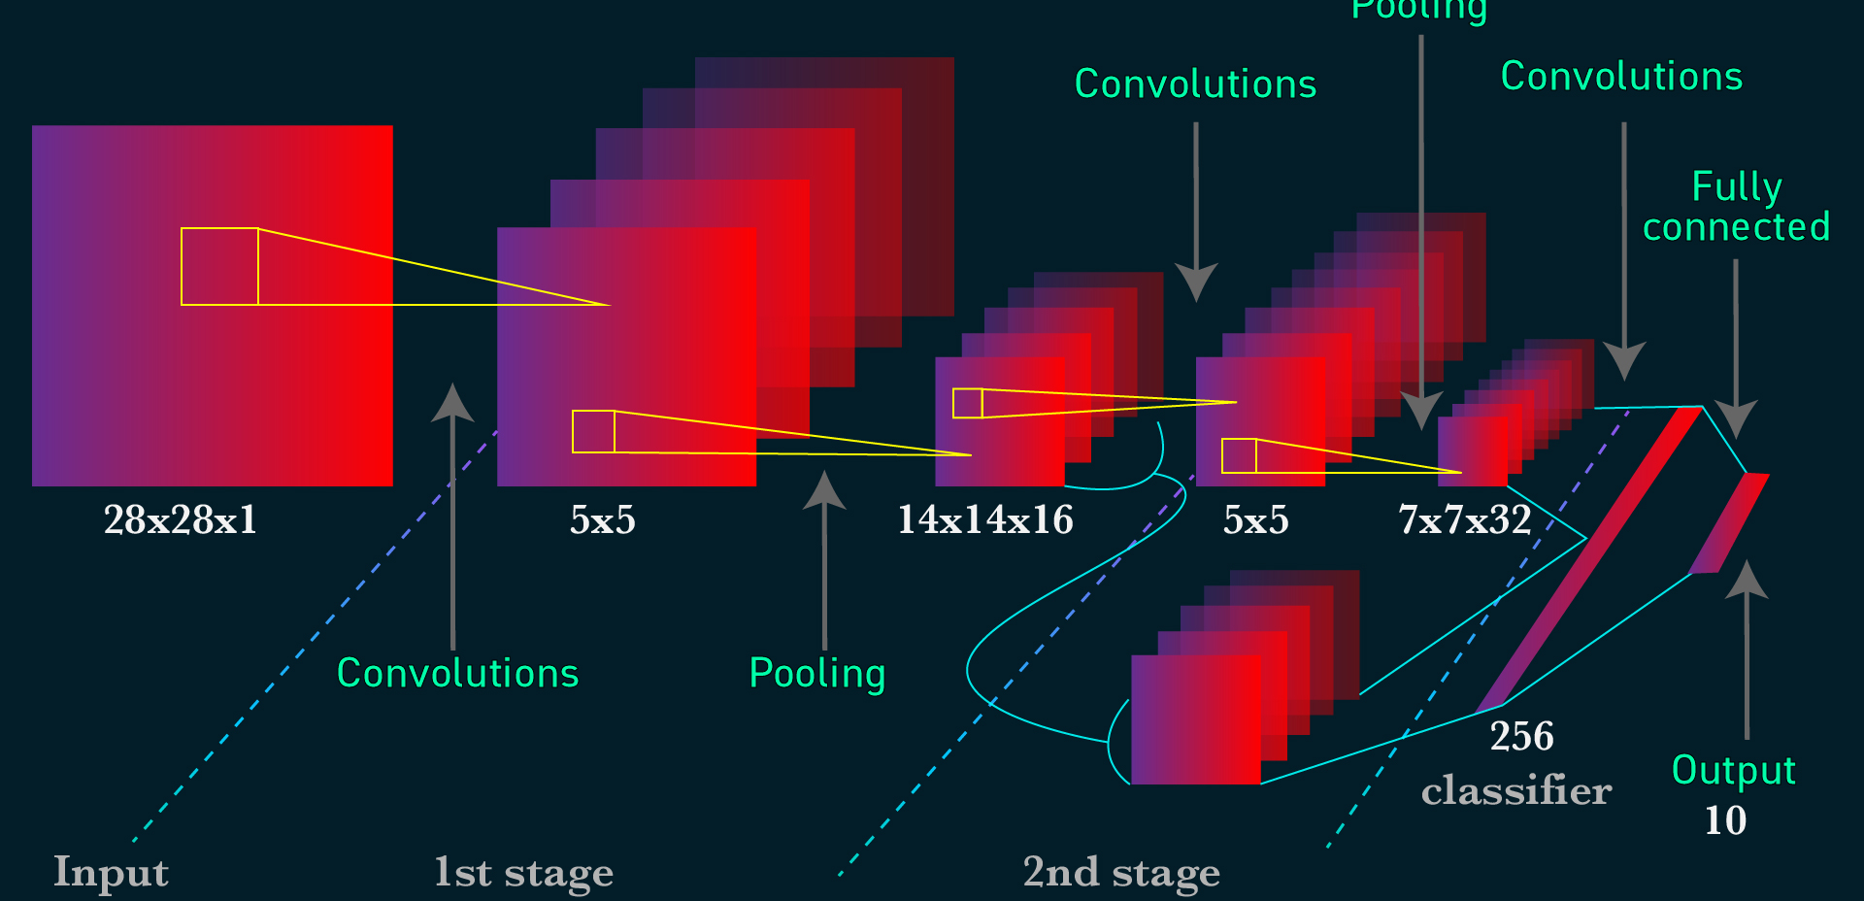
COMPONENTS OF STUDY
CNN-
for image classification and recognition

Slide 11
COMPONENTS OF STUDY
Clustering Algorithms
Identify patterns in sensor data for accurate object classification.
Examples: K-means, Multi-class neural networks.
Regression Models
Predict the future state of objects in the environment.
Examples: Regression random forest, Bayes regression.

Slide 12
COMPONENTS OF STUDY
Communication Protocols
V2X (Vehicle-to-Everything): Enables interaction between the vehicle and external systems.
V2V (Vehicle-to-Vehicle):
Vehicles share data on speed, position, and route intentions.
Helps avoid collisions and improve traffic flow.
V2I (Vehicle-to-Infrastructure):
Communicates with traffic lights, road signs, and infrastructure for route optimization.
V2N (Vehicle-to-Network):
Connects vehicles to the cloud for broader data analysis and updates.
V2P (Vehicle-to-Pedestrian):
Detects and interacts with pedestrians for safety in urban environments.

Slide 13
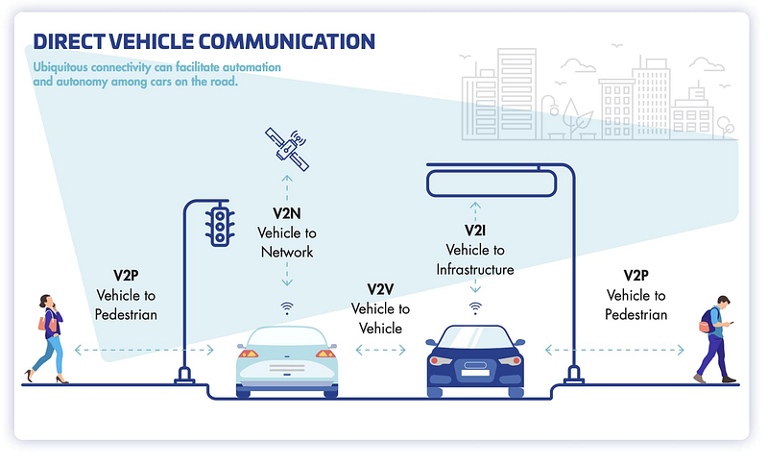
COMPONENTS OF STUDY

Slide 14
COMPONENTS OF STUDY
Power Management Systems
Efficient power usage is critical for IoT-enabled AVs, which rely heavily on sensors and processing units.
Energy-Efficient Sensors:
Reducing the energy footprint of IoT devices.
Battery Management:
Optimizing power usage across sensors, processors, and communication units.
Regenerative Systems:
Using kinetic energy from vehicle motion to recharge batteries.

Slide 15
INTERPRETATION OF THE CASE
Key Observations
Integration of Sensors:
The combination of LiDAR, radar, cameras, and ultrasonic sensors enables autonomous vehicles to perceive their surroundings with high accuracy.
Sensors provide redundancy, ensuring reliability in detecting obstacles and navigating complex environments.
Impact of V2X Communication:
V2V and V2I systems improve traffic flow, reduce congestion, and enhance safety by enabling vehicles to "talk" to each other and infrastructure in real-time.
Example: Vehicles can adjust speeds dynamically based on real-time traffic data.
Real-Time Data Processing:
Edge computing reduces latency, ensuring faster responses to dynamic situations (e.g., sudden obstacle detection).
Cloud computing supports long-term analysis for predictive maintenance and route optimization.
Predictive Maintenance:
IoT-enabled systems can forecast component failures, reducing unexpected breakdowns and maintenance costs.

Slide 16
INTERPRETATION OF THE CASE
Advantages of IoT in AV Monitoring Systems
Improved Safety:
IoT systems detect and respond to obstacles faster than humans, significantly reducing accidents.
Adaptive cruise control and automated braking systems enhance passenger safety.
Enhanced Efficiency:
Optimized routes based on real-time traffic data save time and reduce fuel consumption.
Smooth driving patterns lead to reduced wear and tear on vehicle components.
Environmental Benefits:
Reduced carbon emissions due to optimized fuel usage and integration with electric vehicle technologies.
IoT systems facilitate eco-friendly driving through real-time monitoring.
Better Traffic Management:
IoT enables vehicles to interact with smart infrastructure, leading to smoother traffic flow.
Example: Adaptive traffic lights adjust based on real-time vehicle density.

Slide 17
INTERPRETATION OF THE CASE
Challenges and Limitations
Data Processing Bottlenecks:
High volumes of data from multiple sensors require significant computational power and storage.
Delays in processing can compromise real-time decision-making.
Environmental Limitations:
Adverse weather conditions like rain, fog, or snow can affect sensor accuracy.
Poor visibility may reduce the effectiveness of cameras and LiDAR.
Cybersecurity Risks:
IoT systems are vulnerable to hacking, posing risks to passenger safety and data privacy.
Example: Unauthorized access to V2X communication can disrupt traffic systems.
Infrastructure Dependency:
AVs require well-maintained IoT-enabled infrastructure (e.g., smart traffic lights, well-mapped roads).
Deployment is limited in rural or underdeveloped areas.
Legal and Ethical Issues:
Ambiguity in liability during accidents involving AVs: Should the manufacturer, software developer, or passenger be held responsible?
Ethical dilemmas in decision-making algorithms (e.g., choosing between two accident scenarios).

Slide 18
THE EXPERIMENT
Experiment Setup
Hardware Components:
Sensors: LiDAR, radar, cameras, ultrasonic sensors, and GPS modules.
Processing Units: Edge computing devices for local data processing and cloud servers for large-scale analysis.
Communication Devices: 5G-enabled modules for V2V and V2I communication
Software Components:
Machine Learning Algorithms: Convolutional Neural Networks (CNNs) for object detection, Principal Component Analysis (PCA) for data reduction, and YOLO for obstacle classification.
IoT Platform: A centralized system for managing connected devices, collecting data, and enabling decision-making.
Testing Environment:
Urban Scenario: Simulated city environment with heavy traffic and dynamic obstacles.
Highway Scenario: High-speed travel with fewer obstacles but varying weather conditions.
Controlled Lab Testing: Ensuring sensor accuracy and algorithm performance in a controlled environment.

Slide 19
THE EXPERIMENT
Process and Results
Process:
Step 1: Sensors collected real-time data on vehicle surroundings (obstacles, lane markings, traffic signs).
Step 2: Edge computing processed data locally to make instant decisions (e.g., braking or steering).
Step 3: Data was transmitted to the cloud for long-term storage and trend analysis.
Step 4: Machine learning algorithms analyzed data to improve decision-making (e.g., recognizing patterns in pedestrian movement).
Step 5: Predictive maintenance systems used sensor data to anticipate potential failures and generate alerts.
Key Results:
Obstacle Detection Accuracy: IoT-enabled sensors achieved 95% accuracy in detecting and classifying objects in varied environments.
Latency Reduction: Edge computing reduced response time by 40% compared to traditional cloud-only systems.
Traffic Flow Optimization: V2X communication improved traffic flow by 30%, reducing congestion in urban areas.
Maintenance Efficiency: Predictive systems reduced unexpected breakdowns by 25%, enhancing vehicle uptime.
Weather Adaptability: While performance declined slightly in adverse weather, sensors maintained an 85% effectiveness rate.

Slide 20
CHALLENGES
Technical Challenges
Sensor Limitations - Adverse weather conditions
Latency in Real-Time Processing - Handling large volumes of data from multiple sensors
Map Dependency - Changes in infrastructure (e.g., road construction) may render maps outdated
Cybersecurity Risks
Increased Vulnerability - unauthorized control of the vehicle or data breaches.
Weak Device Security - lack robust encryption
Environmental Challenges
Weather Conditions.
Infrastructure Limitations:
Ethical and Legal Challenges
Liability Issues - Determining responsibility in the event of an accident
Decision-Making Dilemmas.

Slide 21
INFERENCES
Key Findings
IoT as a Game-Changer.
Impact on Road Safety.
Predictive Maintenance Benefits.
Efficiency and Sustainability:
Challenges Still to Overcome
Technical Challenges.
Cybersecurity Risks.
Infrastructure Dependency.
Significance of Findings
Technological Advancements.
Pathway to Smarter Cities.
Enhanced User Experience.

Slide 22
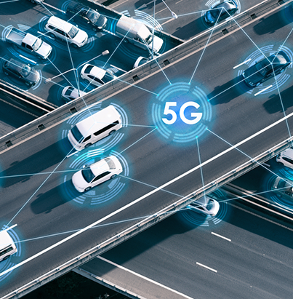
FUTURE SCOPE
Technological Advancements in IoT and AVs
Next-Generation Sensors:
Improved Range and Accuracy.
All-Weather Performance.
Robust Edge Computing:
Processing closer to the vehicle will become even more efficient, reducing latency and ensuring immediate decision-making.
Enhanced Communication Systems:
5G and Beyond.
Vehicle Swarming - Coordinated movement of AVs for tasks such as platooning, improving fuel efficiency, and reducing congestion.
AI and Machine Learning Integration:
Adaptive Algorithms.
Self-Learning Systems.

Slide 23

FUTURE SCOPE
Broader Applications and Urban Integration
Smart City Ecosystems:
IoT-Enabled Infrastructure.
Public Transport Automation.
Real-Time Urban Planning
Environmental Benefits:
Emission Reductions.
Sustainability Metrics.
Advanced Cybersecurity Protocols:
Blockchain Integration.
Encryption Upgrades
Global Impact:
Widespread Adoption.
Economic Growth

Slide 24
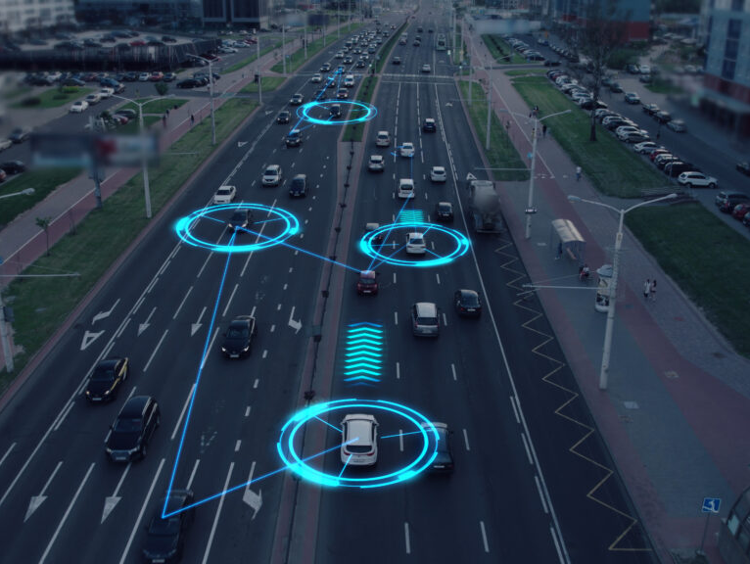
THANK YOU!

